Slide 1
Student Lifestyle & Academic Performance Analysis
Exploring How Lifestyle Habits Impact Academic Outcomes
Presented by: Sudham Salagar Tool Used: Microsoft Excel

Slide 2
Objective
Goal of the Project:
Analyze student lifestyle data to uncover patterns affecting grades and stress.
Identify correlations between habits like study time, sleep, activity, and academic performance.
Provide actionable insights using Excel visualizations.

Slide 3
Dataset Overview
Columns in Dataset:
Study Hours, Sleep Hours, Social Time, Physical Activity
Stress Level, Gender, Grades
Data Size: 2000 students
Cleaning Done:
Removed duplicates/blanks
Ensured proper data types

Slide 4
Data Preparation
Derived Columns:
Grade Category: A, B, C, D/F (Based on Grade thresholds using IF formula)
Stress Category: Low, Moderate, High (Based on Stress Level ranges)

Slide 5
Pivot Table 1 – Grades by Gender
Rows: Gender
Values: Avg. Grades, Count of Students
Chart: Bar Chart
🎯 Insight: “Males scored slightly higher on average."

Slide 6
Pivot Table 2 – Study Time vs Grades
Grouped Study Hours 3–5, >5
Values: Average Grades
Chart: Line or Bar Chart
🎯 Insight: "Grades peak at 2–4 hours of study."

Slide 7
Pivot Table 3 – Sleep Hours vs Stress
Grouped Sleep Hours
Values: Average Stress Level
Chart: Bar Chart
🎯 Insight: "Students sleeping 7 hours reported lower stress."

Slide 8
Pivot Table 4 – Physical Activity vs Grades
Physical Activity Hours
Values: Average Grades
Chart: Bar Chart
🎯 Insight: "Moderate physical activity linked to better grades."

Slide 9
Dashboard Preview
Contains:
All Pivot Charts
Slicers for filtering by Gender, Grade Category
Conditional Formatting 🎯 Easy to interact with and compare patterns

Slide 10
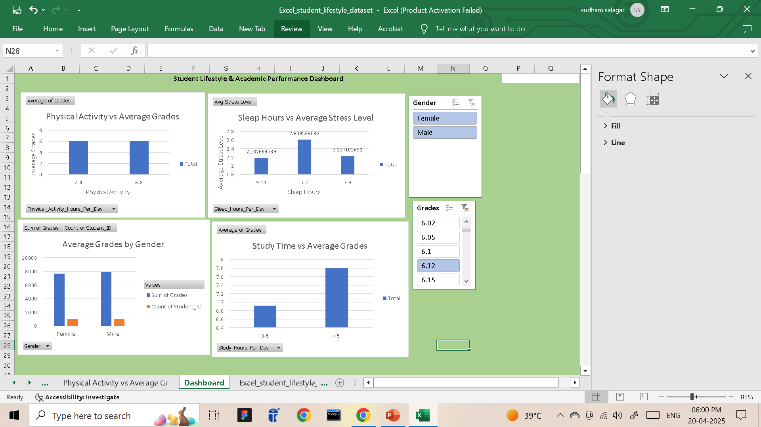
screenshot of your Excel dashboard

Slide 11
Key Insights & Recommendations
💬 More sleep → less stress
📚 2–4 hours of daily study → better performance
🏃‍♂️ Physical activity contributes to improved grades
👩 Gender may influence outcomes slightly (optional)

Slide 12
Conclusion
Summary:
Excel helped reveal how lifestyle impacts performance
Visual analysis supports actionable student habits
Dashboard enables dynamic data filtering

